Slide 1
Heart Attcak Prediction-Final Project
Supervised By: Ahmed Mostafa
Presented By: Reem Nabil Abdelaziz

Slide 2
About Dataset
This dataset provides a collection of features relevant to heart health and lifestyle choices, containing patient-specific details such as age, gender, cholesterol levels, blood pressure, heart rate.
Also include indicators like diabetes, family history, smoking habits, obesity, and alcohol consumption.
Additionally, lifestyle factors like exercise hours, dietary habits, stress levels, and sedentary hours are included.
Medical aspects comprising previous heart problems, medication usage, and triglyceride levels are considered.
Socioeconomic aspects such as income and geographical attributes like country, continent, and hemisphere are incorporated.

Slide 3
The dataset, consisting of 8763 records from patients around the globe, culminates in a crucial binary classification feature denoting the presence or absence of a heart attack risk, providing a comprehensive resource for predictive analysis and research in cardiovascular health.
This dataset include 26 column and target will be “Heart Attack Risk” which are:
1) Patient ID - Unique identifier for each patient.
2) Age - Age of the patient.
3) Sex - Gender of the patient (Male/Female).
4) Cholesterol - Cholesterol levels of the patient.

Slide 4
5) Blood Pressure - Blood pressure of the patient (systolic/diastolic).
6) Heart Rate - Heart rate of the patient.
7) Diabetes - Whether the patient has diabetes (Yes/No).
8) Family History - Family history of heart-related problems (1: Yes, 0: No).
9) Smoking - Smoking status of the patient (1: Smoker, 0: Non-smoker).
10)Obesity - Obesity status of the patient (1: Obese, 0: Not obese).
11)Alcohol Consumption - Level of alcohol consumption by the patient (None/Light/Moderate/Heavy).
12)Exercise Hours Per Week - Number of exercise hours per week.
13)Diet - Dietary habits of the patient (Healthy/Average/Unhealthy).
14)Previous Heart Problems - Previous heart problems of the patient (1: Yes, 0: No)
15)Medication Use - Medication usage by the patient (1: Yes, 0: No)
16)Stress Level - Stress level reported by the patient (1-10)

Slide 5
17)Sedentary Hours Per Day - Hours of sedentary activity per day.
LOW risk indicates sitting with no physical activity less than 4 hours per day.
MEDIUM risk indicates sitting 4 to 8 hours per day.
HIGH risk indicates sitting 8 to 11 hours per day
VERY HIGH risk indicates sitting more than 11 hours per day
18)Income - Income level of the patient.
19) BMI - Body Mass Index (BMI) of the patient. (weight -kg- /height -m^2-) when lower than 18.5 ; you are in the underweight.
Between 18.5 till 24.9 ➔ you are in the healthy weight range.
Between 25 and 29.9 ➔ you are in the overweight range.
30 or over ➔ your are in the obese range.
20)Triglycerides - Triglyceride levels of the patient.
21)Physical Activity Days Per Week - Days of physical activity per week.
22)Sleep Hours Per Day - Hours of sleep per day.
23)Country - Country of the patient.
24)Continent - Continent where the patient resides.
25)Hemisphere - Hemisphere where the patient resides.
26)Heart Attack Risk - Presence of heart attack risk (1: Yes, 0: No). => this is the “target”

Slide 6
Dealing with missing Data
There are missing data in two columns which are :
1) Exercise Hours Per Week ➔ This is Numerical data so check first if there is an outliers using “BOX PLOT” and the result was that there is no outliers found so the fill was with using MEDIAN.
2) Hemisphere ➔ This is categorical data so the fill was with using MODE.

Slide 7
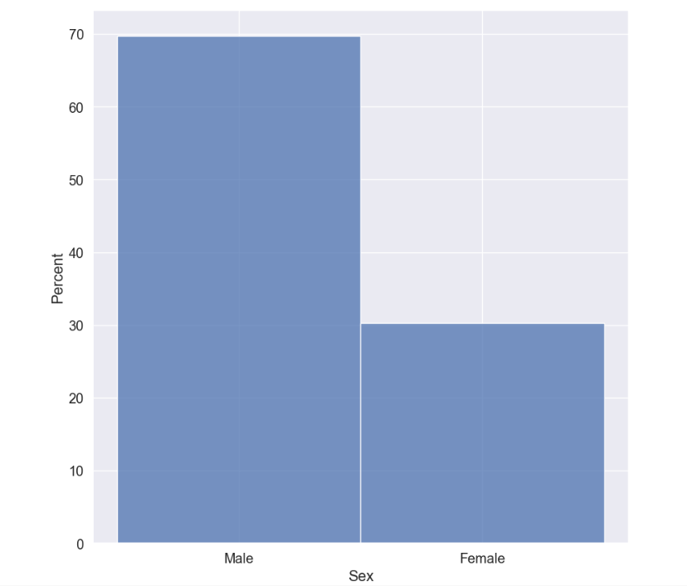
EDA-Univariate
Univariate Results:
From univariate diagrams the results as per below:
1) 70 % from patients that mentioned in dataset were Males while 30 % from patients were females.

Slide 8
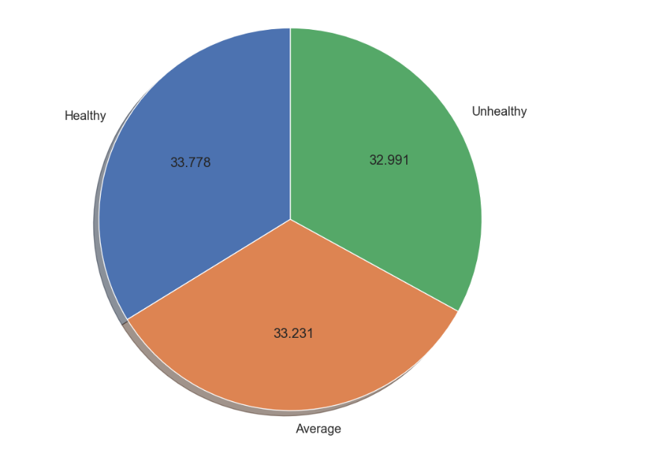
2) The more percentage regarding "DIET" feature considering "33.778" as healthy patients then "33.231" as average while "32.991“ as unhealthy patients.

Slide 9
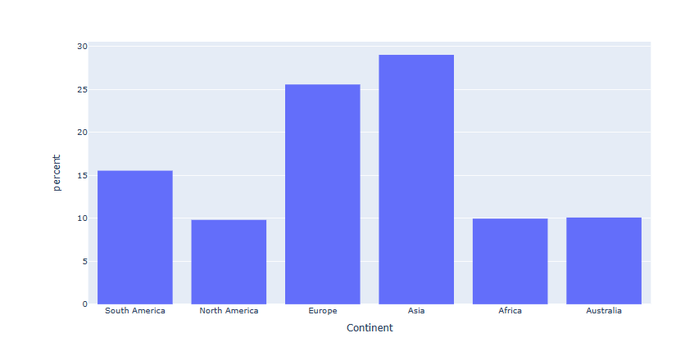
3) "Asia Continent" is existed with percentage 29% then "Europe" with percentage 25.57% and the less percentage was for "Africa" then "North America".

Slide 10
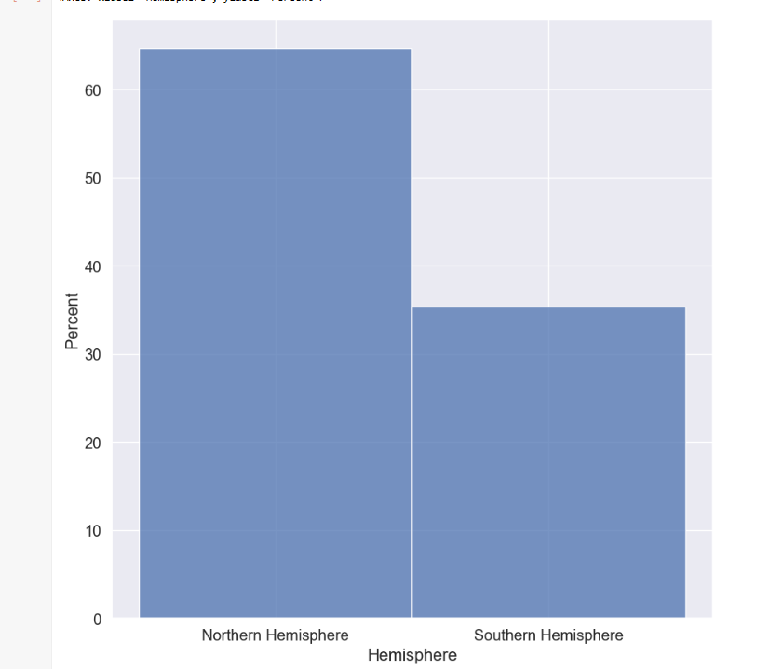
4) "Northen Hemisphere" is existed with percentage more than 60%.

Slide 11
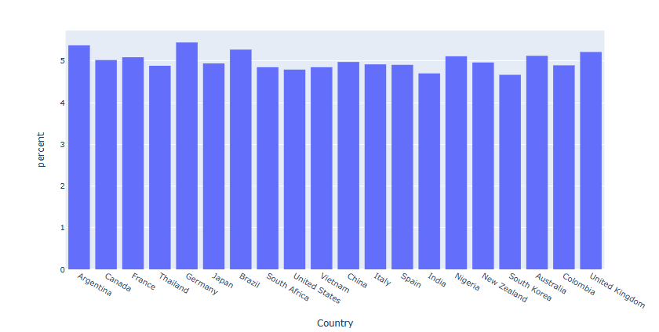
5) The countries that exist more were for "Germany and Nigeria" while the less countries mentioned was belong to "south koria".

Slide 12
6) The diabetes patients with percentage 65.2%
7) 50.7% of patients have family history.
8) 89.7% of patients are smoker and also 50.1 of them suffering "obesity".
59.8 % of patients consume alkhol.

Slide 13
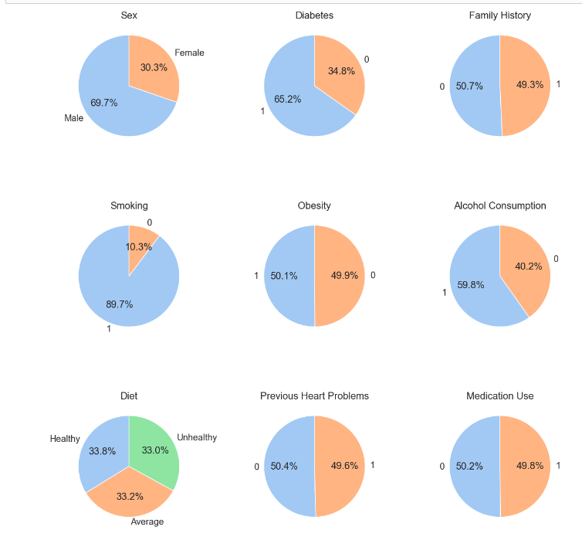

Slide 14
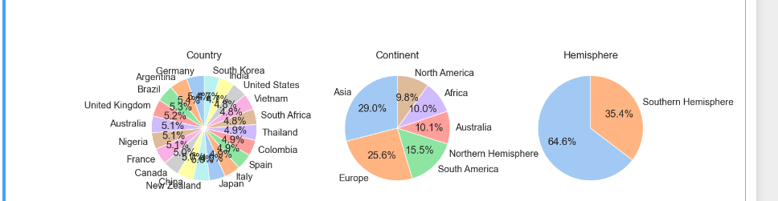

Slide 15
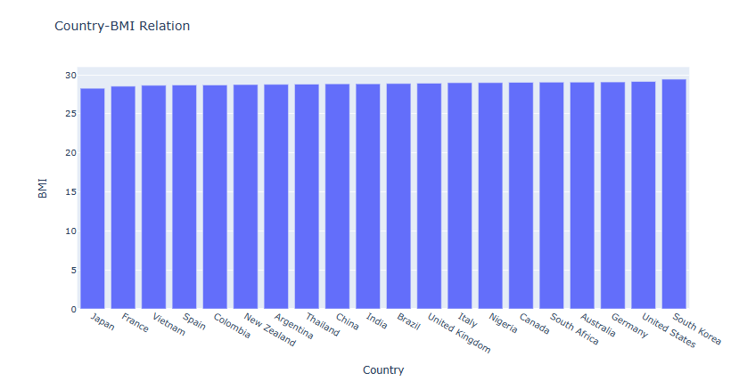
EDA-Bivariate
The countries which are "South Korea" , "United States" , "Germany" countries having more "BMI" while the less BMI belongs to "Japan" , "France" , "Vietnam".

Slide 16
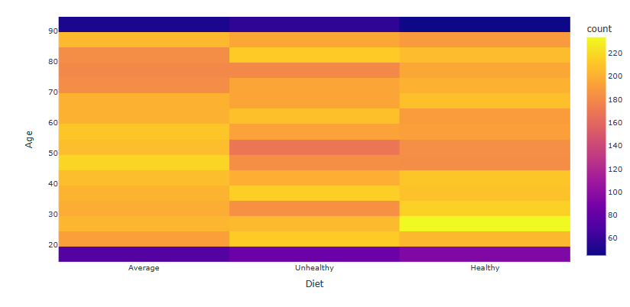
2) Age between "20" and "24" are unhealthy but more than 25 years till 29 years are healthy ; and the ages between 80 and 84 unhealthy persons.

Slide 17
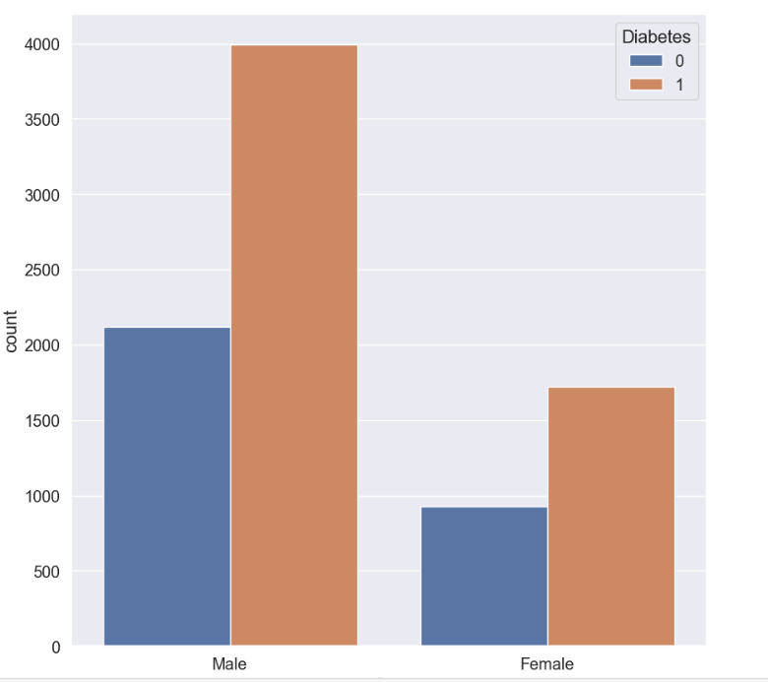
3) Males that having diabetes were more than females with diabetes.

Slide 18
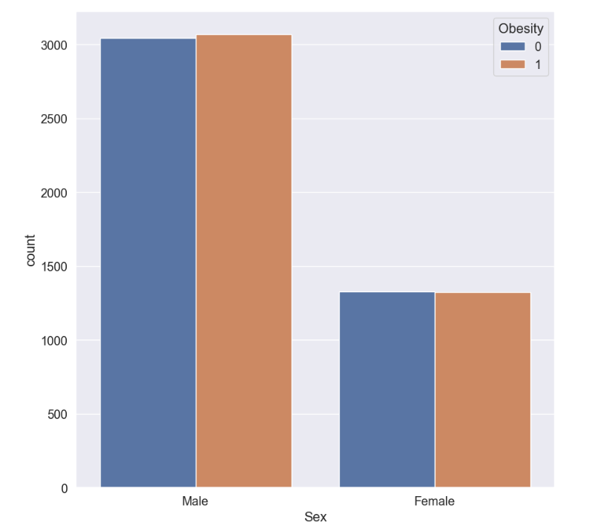
4) Obesity Males are more than Non-Obesity Males and also more than Obesity females.
While obesity and Non-obesity in females are equal in percentage.

Slide 19
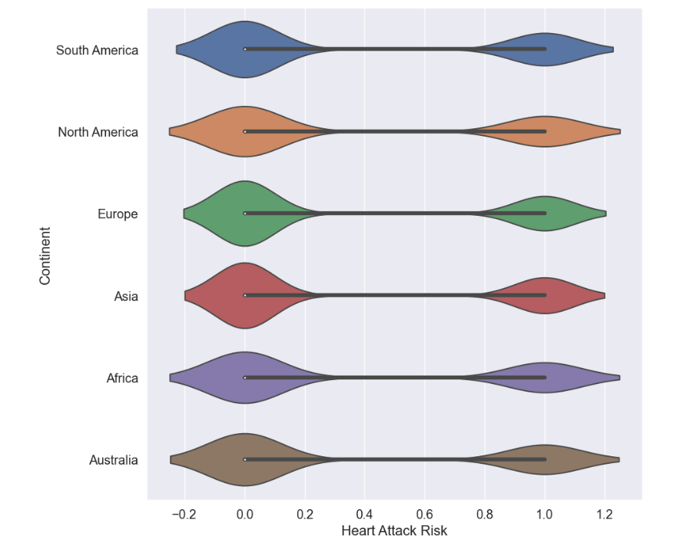
5) "North America Continent" and "Africa " are the most suffering from "heart attack risk" while for "Europe" and "Asia" are less suffering from "heart attack risk".

Slide 20
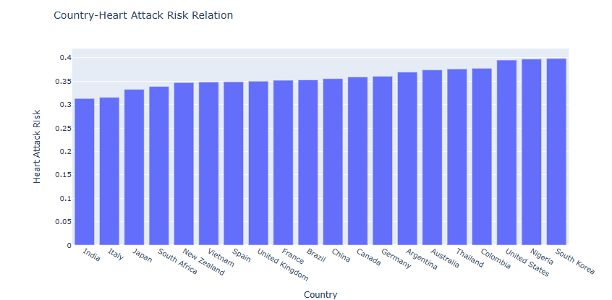
6) The countries who are suffering from "heart attack risk" belong to "South Korea" , "Nigeria" and “United States”
while the less countries that are suffering from "heart attack risk" belong to "India" ,"Italy“ and “Japan”.

Slide 21
In Univariate using 6 visualization between "histplot" , "Pie chart" and "histogram".
In Bivariate using 8 visualization using heatmap , violin plot ,sns.countplot , px.bar.

Slide 22
Dealing with Dataset before feature selection
The below fields dropped from dataset:
Patient ID .
Country .
Continent .
Hemisphere .
Blood Pressure.
Then use Map Function in ordinal encoding in “DIET” column;
To make 'Unhealthy’ refer to (0) and 'Average’ to (1) while Healthy refer to (2).
Then using get dummies for gender “Sex” to be divided into males and females.
Then converting 'Object' and 'Boolean' Datatype into integer for fields:
(Systolic , Diastolic , Sex_Female,Sex_Male).

Slide 23
Feature Selection
In feature selection ; I have used two technique which are:
1) High Correlation Filter.
2) Random forest.
And the result that observed from using the two techniques as per below:
Heart attack prediction not much dependent on the below so it will be better to drop them in case its required to know which the Machine learning algorithm having more testing and train accuracy:
1) smoking
2) diastolic
3) obesity
4) previous heart problems.
5) diabetes
6)family history
7) Alcohol Consumption
8) Medication level
9)Gender

Slide 24
Heart attack prediction is much dependent on the below:
1) Sedentary Hours Per Day. (more sedentary hours per day , more heart attack risk prediction).
2) BMI.
3) Exercise Hours per week.
4) Income.
5) Triglycerides.
6) Cholesterol.
7) Age.
8) Heart Rate.
9)Systolic.
10) Stress level.
11) Physical Activity Days Per Week.
12) Sleep Hours Per Day.
13) Diet
And heart attack risk column will be the “target”.

Slide 25
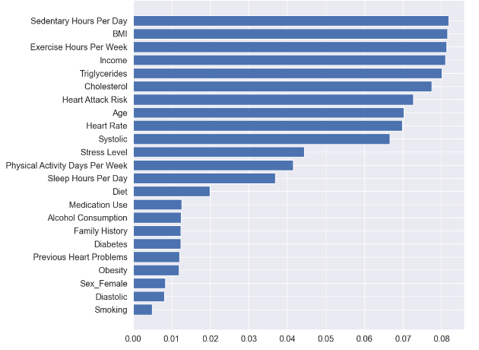

Slide 26
Modelling
Hyperparameter Tunning:
Hyperparameter Tunning directly affects model performance.
➔ Each model has its hyperparameter and each parameter has number of different values so the question now :
which the best values of this parameter that achieve the best performance and accuracy?
And Hyperparameter Tunning answer this question.
Hyperparameter Tunning such as : GridsearchCV and Randomized Search.

Slide 27
Difference between Hyperparameter Tunning Techniques:
1) GridsearchCV:
GridSearchCV exhaustively considers all parameter combinations.
GridsearchCV advantage: more accuracy than Randomized Search as in Gridsearch try all the possibilities in value range and running models depend on number of possibilities.
GridsearchCV disadvantage: take a lot of time and high cost.
2) Randomized Search:
here try random values and learn random models.
Randomized Search advantage: cost and time reduction.
Randomized Search disadvantage: less accuracy than GridsearchCV .

Slide 28
The Technique that be used here is : Gridsearch Technique.
I will use the Gridsearch Technique for below Models:
SVC.
KNN.
Random Forest.
The best Recall score after applying this technique over above Models ; was belong to “Random Forest” model with Recall score (0.6433666191155493) ;
And its best param of grid search for random forest model is:
{'max_depth': 5,
'min_samples_leaf': 1,
'min_samples_split': 2,
'n_estimators': 100}

Slide 29
ML Classification
After Applying classification different algorithms ; the better Model and algorithm is for Random forest model with:
- accuracy_training: 0.6609129814550642
- accuracy_testing: 0.6360524814603536
- recall score: 0.6354820308043354
- precision score: 0.40383741147520236
Then I use this Model to be applied .
Here in this project ; the best performance metrics is recall. As if the false negatives decrease, the recall increases. False negative means that the classifier predicts that the patient has no heart risk and he has heart risk truly. So, for this I choose the Recall as the my focused performance metric.

Slide 30
Streamlit and GITHUB Links
gitub link : https://github.com/Reem304/Heart-Attack-Prediction.
streamlit link: https://heart-attack-prediction-ngfud32evwdq82hqmvkzfv.streamlit.app/

Slide 31
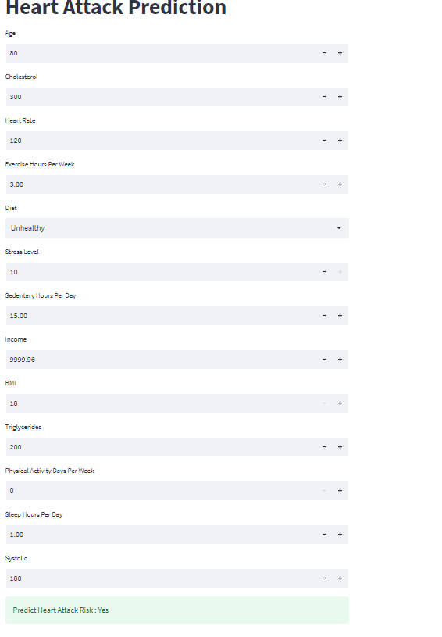
After Streamlit Deployment
The below snapshot show trial of inputting features and the result was that predict “the risk of heart attack” when inputting those values.

Slide 32
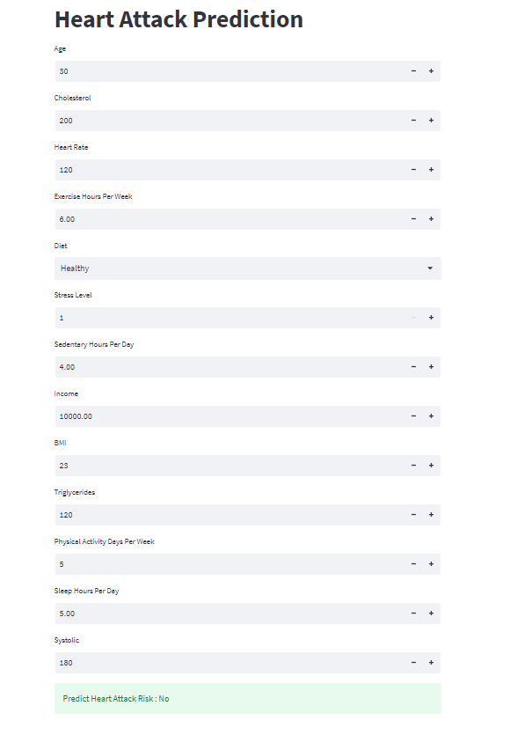
The below snapshot show trial of inputting features and the result was that not predict “the risk of heart attack ” when inputting those values.

